Slide 1
Product Marketing and Selling Portal
K.S.School of Business Management
Group Id:19
Misha Thakkar:5079

Slide 2
Company Profile
The Gateway Corp, a privately held global enterprise, is headquartered in India and The Netherlands.
The Gateway Corp is the principal holding company and promoter of all Gateway Group Companies, comprising of 20 independent operating companies across 16 countries.
Our Vision 2023 is built on this foundation.
The aggressive strategy for organic and inorganic growth entails – development of disruptive solutions, strategic initiatives & partnership and new markets penetration.

Slide 3
Company Name | The Gateway Group of Companies
Company Address | B/81, Corporate House, Judges Bunglow Road, Bodakdev, Ahmedabad, Gujarat 380054
Company Established | 1997
Contact Person | Vandita Dhariya
Contact no | 8527221753
Website | https://thegatewaycorp.com/
Services | Solution Consulting Digital Transformation IT Services Products & Platforms

Slide 4
Existing System
Current systems do not support return and replacement of products.
Current systems do not provide functionality to cancel pre-requested orders.
Current systems do not support payment gateway for product purchasement.
Current systems do not provide functionality to share product details to others.
Current systems do not provide user contact/complaint forum.

Slide 5
Proposed System
There are only few web portals available which provides functionality as our web application.
One of the best advantage of our portal is product purchasement security, manually verified buyers & sellers and 100% secured buyer’s & seller’s information (Like order details, personal details, user’s cart details etc.).

Slide 6
Scope Of System
Create and manage different users with varied roles and scopes for admin.
Create and manage products details for admin.
Create and manage locations details for admin.
Create and manage categories details for admin.
Create and manage events details for admin.
Create and manage user’s cart products for admin.
Manage add new product requests for admin.

Slide 7
Manage add new event requests for admin.
Manage product purchase requests for admin.
Create and manage all server configuration for admin
Manage error logs and user interaction logs for admin
Manage product purchase status for admin.
Promote (Request to Add) Own Product for login user and guest.
Request to add new Event for login users and guest.

Slide 8
Objectives
Product Marketing and Selling Portal is E-Commerce Portal written in C# language,.NET MVC framework based
which supports promoting and selling a product to a customer also it is defined as being the intermediary function between product development and product selling.
It provides facility to users for select the product according to their choice of category and location.
Main objective of our portal is to :
enable time management
secure transaction without data loses
making easy system
So that people can easily find their product information which they want.

Slide 9
CHAPTER :2 PROPOSED SYSTEM REQUIREMENT GATHERING

Slide 10
STACKHOLDER OF SYSTEM
Admin
Manage user regarding roles, user accessibility and system configurations.
Manage application data regarding product, categories, locations and events details.
Manage requests regarding add new product, add new event and purchase products.
Manage product purchasement status and user verification(manually).
Admin has full access to check app logs and reports of user access.
Admin can manage user regarding roles, user accessibility and system configurations.
Admin can manage application data regarding product, categories, locations and events details.
Admin can manage requests regarding add new product, add new event and purchase products.
Admin can manage product purchasement status and user verification.
Admin has full access to check app logs and reports of user access

Slide 11
Login User
Login User can add product to cart and purchase product according to their choice of category and location from portal.
Login User can request to add new product and also can request to add new event.
Login User can also check status of requested for purchase a product.
Registered User can add product to cart and purchase product according to their choice of category and location from portal.
Registered User can request to add new product and also can request to add new event.
Registered User can check status of requested for purchase a product.

Slide 12
Guest User
Guest User can add product to cart and can interact with portal like login user except purchasing products. To purchase product guest user must be register self.
Guest User can request to add new product and also can request to add new event.

Slide 13
PROJECT DEFINITION
Product marketing & selling portal is web based application.
Product marketing is a process of promoting and selling a product to a customer also it is defined as being the intermediary function between product development and product selling.
This web application provides the facility to users for select the product according to their choice of category and location.
User can only buy the product if he/she is registered user and also User can promote own product into portal.

Slide 14
It helps to user to get products according to their requirement.
It is not complex system.it is user friendly system.
User can purchase the product if they are registered user.
All Users can request to add own product for selling purpose and that request is monitored by Admin
All Users can do request for add event and that request is monitored by Admin.
Admin can manage the product purchase request, add product request and add event request.
Admin can add, update and delete products, categories, locations and events.

Slide 15
CHAPTER 3: SYSTEM MANAGEMENT AND PLANNING

Slide 16
HARDWARE-SOFTWARE REQUIRMENT
HARDWARE REQUIREMENTS
Microsoft Windows 7/8/10 installed computer.
At least 4 GB of RAM.
At least 1 GB of hard disc space

Slide 17
SOFTWARE REQUIREMENTS
Visual studio Community 2017
SQL server 2017
IIS Server
Web browser (Chrome/Explorer/Mozilla Firefox)

Slide 18
SYSTEM PLANNING
WORK BREAKDOWN STRUCTURE
is a hierarchical tree structure that outlines your project and breaks it down into smaller, more manageable portions.

Slide 19
1 PMSP
1.1 Requirement
1.3 Analysis & Design
1.4 Coding
1.6 Maintains & Support
Gathering
1.1.1 Stack Holder of System
1.3.1 UML Diagrams
1.4.1 Code Construction
1.6.1 Service
and Review
1.1.2 Requirement Gathering
1.3.2 System Flow Charts
1.6.2 Facility
Techniques
1.1.3 Finalize Requirement List
1.3.3 Data Dictionary
1.6.3 Feedback
1.1.4 Project Definition
1.3.4 User Interface
1.3.5 System Navigation
1.2 Project
1.5 Testing
Management & Planning
1.2.1 Feasibility Study
1.5.1 Development Testing
1.2.2 H/w S/w Requirement
1.5.2 Operational Testing
1.2.3 Project Management
and planning
1.2.4 Process Model

Slide 20
GANTT CHART
A Gantt chart, commonly used in project management, is one of the most popular and useful ways of showing activities (tasks or events) displayed against time.
On the left of the chart is a list of the activities and along the top is a suitable time scale.
Each activity is represented by a bar; the position and length of the bar reflects the start date, duration and end date of the activity.

Slide 21
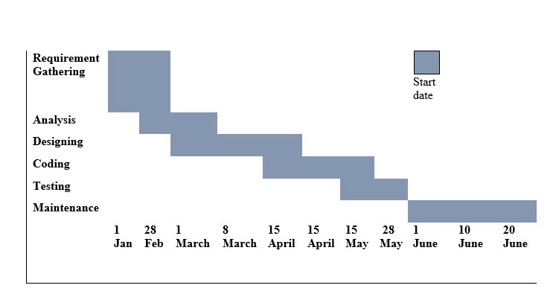

Slide 22
No | TASK NAME | START DATE | FINISH DATE | DURATION
1 | Feasibility study | 27/01/2020 | 01/02/2020 | 1 week
2 | Requirement Gathering and Analysis on gathered requirements | 03/02/2020 | 15/02/2020 | 2 weeks
3 | Designing | 17/02/2020 | 29/02/2020 | 2 weeks
4 | Core Coding | 02/03/2020 | 14/03/2020 | 2 weeks
5 | Actual Coding | 16/03/2020 | 28/03/2020 | 2 weeks
6 | Testing and Maintenance | 30/03/2020 | 13/04/2020 | 2 week
7 | Documentation | 13/04/2020 | 20/04/2020 | 1 week

Slide 23
UML Diagrams
The Unified Modelling Language is standard visual modelling language intended to be used for :
Modelling , business and similar processes.
Analysis, design and implementation of software-based system.
UML can be applied to diverse application domains(e.g. banking, finance, internet, aerospace, healthcare, etc.)
It can be used with all major object and component software development methods and for various implementation.

Slide 24
Usecase Diagram

Slide 25
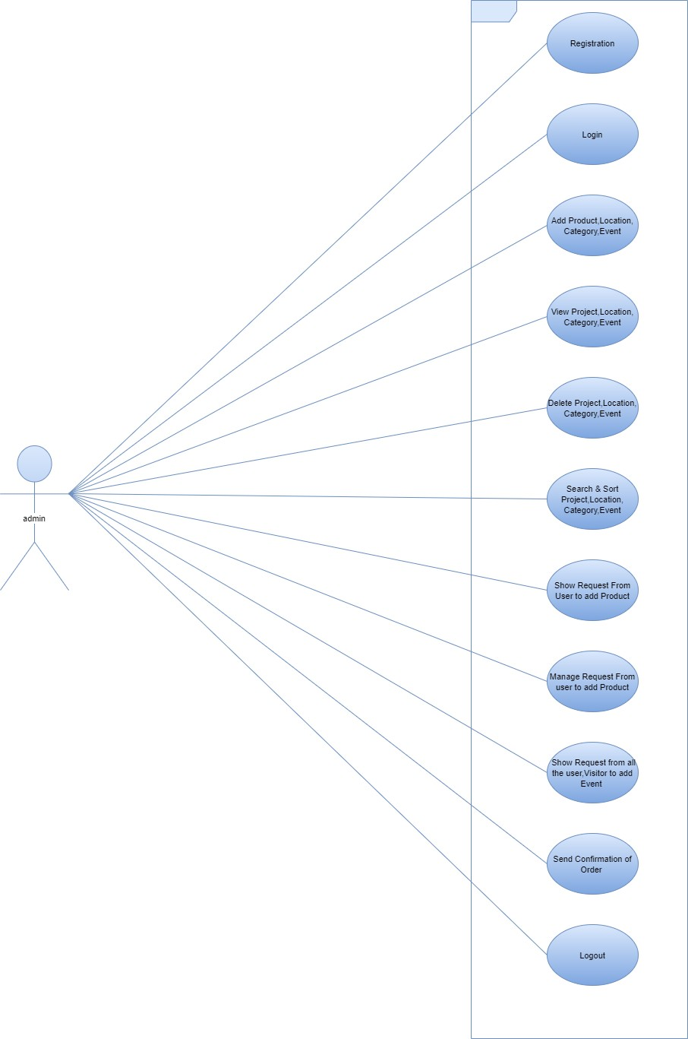
Admin

Slide 26
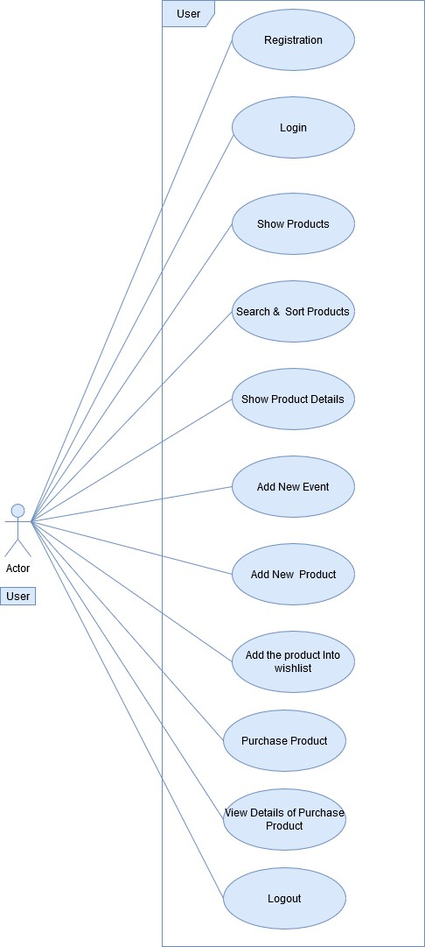
Registered User

Slide 27
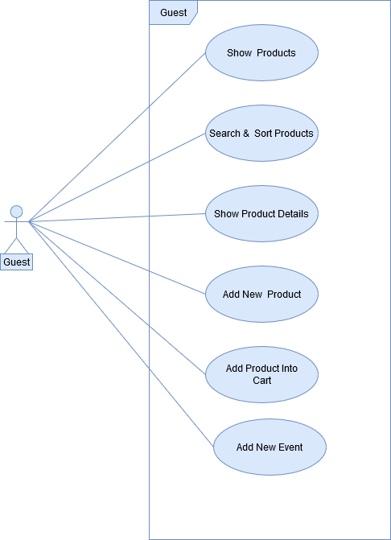
Guest(Visitor)

Slide 28
Activity Diagram

Slide 29
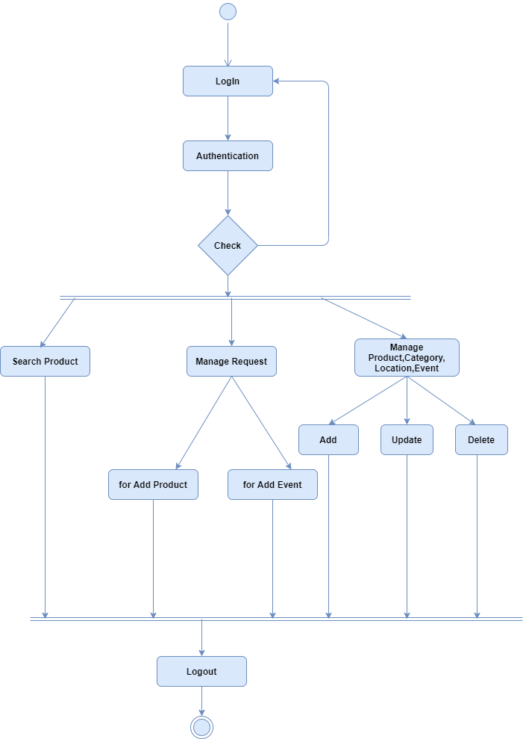
Admin

Slide 30
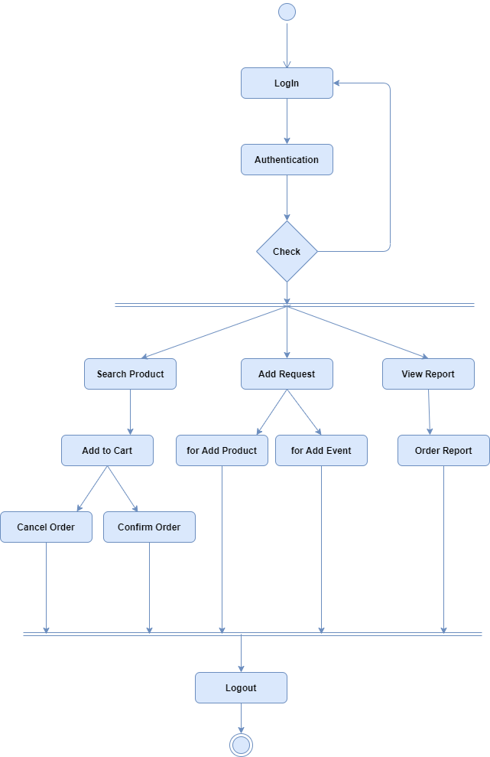
Registered User

Slide 31
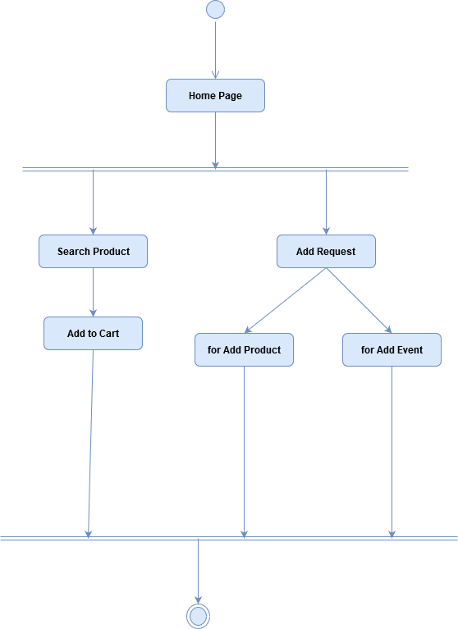
Visitor

Slide 32
Sequence Diagram

Slide 33
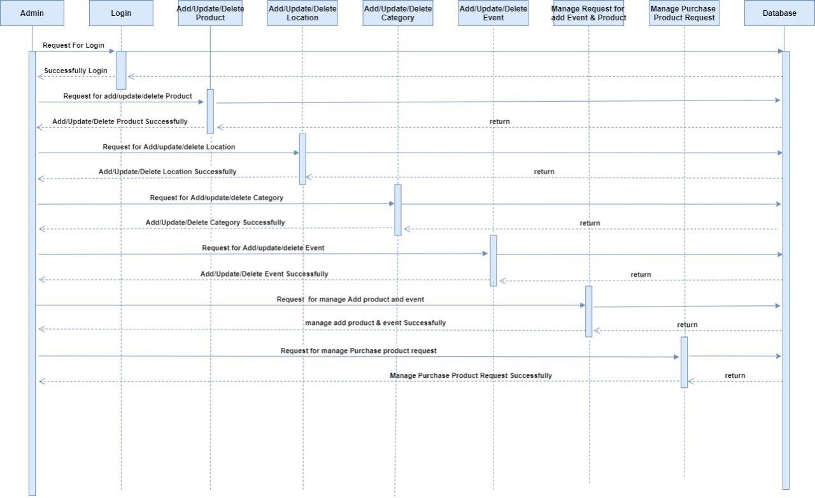
Admin

Slide 34
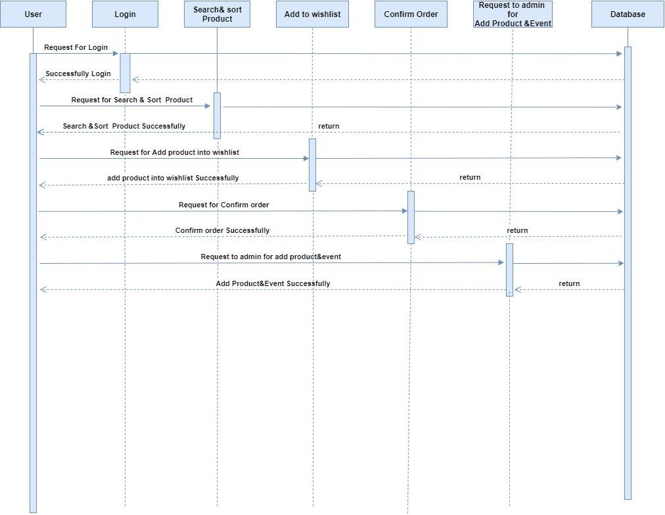
Registered User

Slide 35
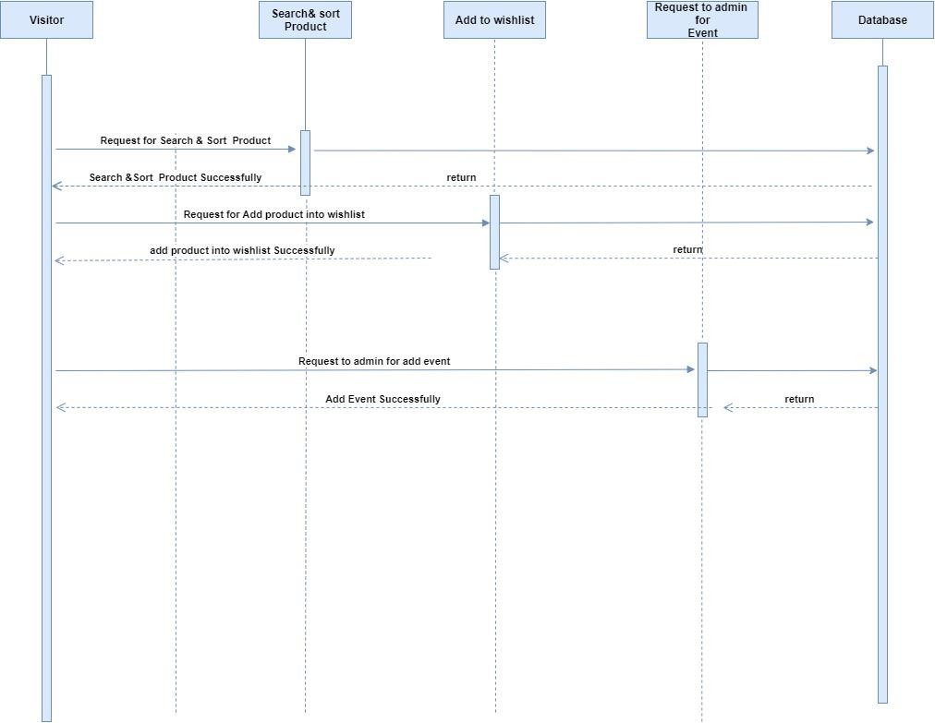
Visitor

Slide 36
Systemflow Diagram

Slide 37
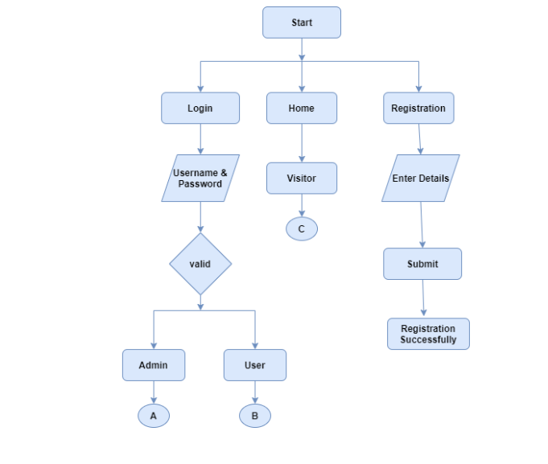

Slide 38
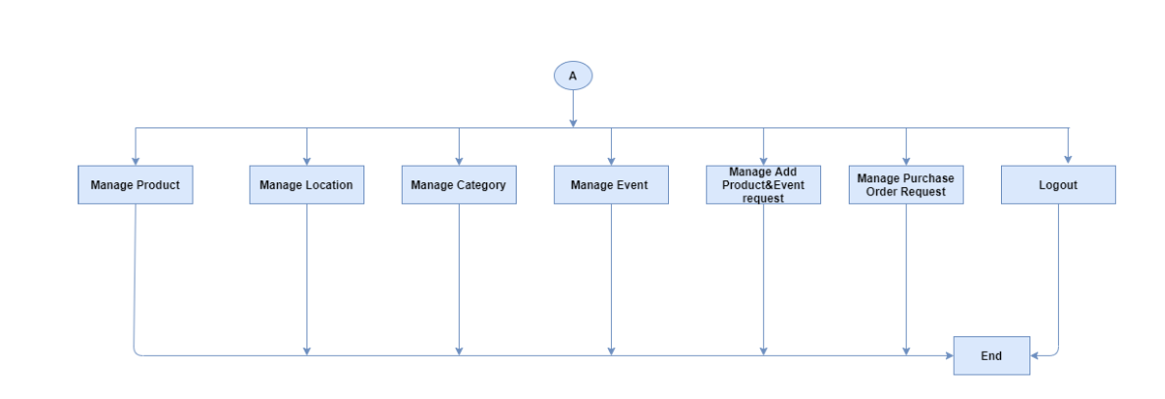

Slide 39
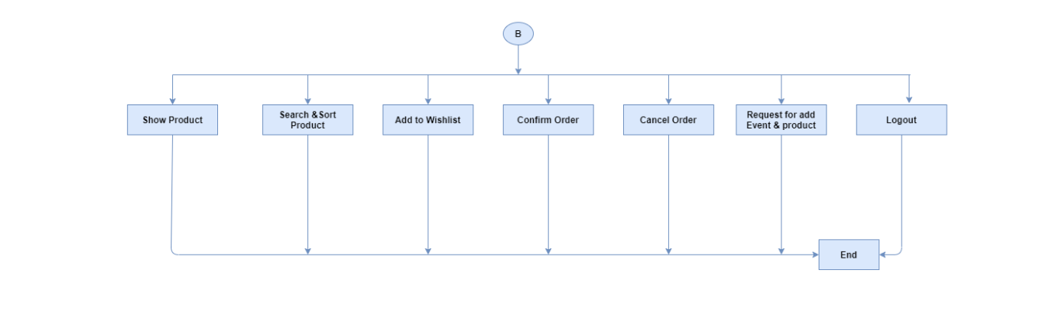

Slide 40
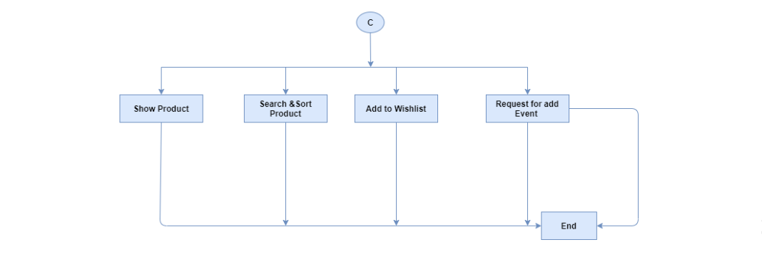

Slide 41
Data Dictionary

Slide 42
Sr.no | Column Name | Data Type | Constraints | Description
1 | RoleId | Integer | Primary Key | It’s represent the id of role .
2 | RoleName | Varchar(50) | Not Null | It’s represent the name of role.
Table Name: tbl_Role
Description: Used to store all type of role Information.

Slide 43
Sr.no | Column name | Data types | Constraints | Description
1 | UserId | Int | Primary key | It’s represent the user id.
2 | RoleId | Int | Foreign Key | It’s represent the RoleId of user.
3 | FirstName | Varchar(50) | Not Null | It’s represent the FirstName.
4 | LastName | Varchar(50) | Not Null | It’s represent the LastName Of the user
5 | Email | nvarchar(50) | Not Null | It’s represent the email.
6 | Address | nvarchar(MAX) | Not Null | It’s represent the current address.
7 | Password | nvarchar(50) | Not Null | It’s represent the password.
8 | ContactNo | int | Not Null | It’s represent the contact No. of user.
9 | IsActive | Bit | Not Null | It’s represent the User is active or not.
Table Name: tbl_User
Description: Used to store all users login and type Information.

Slide 44
Sr.no | Column name | Data type | Constraints | Description
1 | ProductId | Int | Primary key | It’s represent the id of product.
2 | QuantityId | Int | Foreign key | It’s represent the id of Quantity.
3 | ProductName | Varchar(50) | Not null | It’s represent the name of product.
4 | Price | Float | Not null | It’s represent the price of product.
5 | Description | Varchar(100) | Not null | It’s represent the detail of product.
6 | Image | nvarchar(50) | Not Null | It’s represent Image of the product.
7 | EnterBy | Int | Null | It’s represent the id of the user.
8 | EnterDate | DateTime | Null | It’s represent the date and time of entered data.
9 | UpdateBy | Int | Null | It’s represent the id of the user.
10 | UpdateDate | DateTime | Null | It’s represent the date and time of entered data.
Table Name : tbl_Product_master
Description: Used to store all Information about products.

Slide 45
Sr.no | Column name | Data type | Constraints | Description
1 | LocationId | Int | Primary key | It’s represent the id of location.
2 | CountryId | Int | Foreign Key | It’s represent the foreign key countryid .
3 | StateId | Int | Foreign Key | It’s represent the foreign key stateid of location.
4 | CityId | Int | Foreign Key | It’s represent the foreign key cityid name
5 | Address | Varchar(200) | Not null | It’s represent the address.
6 | LandMark | Varchar(100) | Not Null | It’s represent the landmark of the location.
7 | Pincode | Bigint | Not Null | It’s represent the pincode of the location
8 | EnterBy | Int | Null | It’s represent the id of the user.
9 | EnterDate | DateTime | Null | It’s represent the date and time of entered data.
10 | UpdateBy | Int | Null | It’s represent the id of the user.
11 | UpdateDate | DateTime | Null | It’s represent the date and time of entered data.
Table Name : tbl_Location_master
Description: Used to store all Information about Location

Slide 46
Table Name : tbl_Location_Country
Description: Used to store all Information about Location
Sr.no | Column name | Data type | Constraints | Description
1 | CountryId | Int | Primary Key | Its represent the country id .
2 | CountryName | Varchar(50) | Not Null | Its represent the name of country.

Slide 47
Sr.no | Column name | Data type | Constraints | Description
1 | StateId | Int | Primary Key | Its represent the Stateid .
2 | StateName | Varchar(50) | Not Null | Its represent the name of state.
3 | CountryId | Int | Foreign Key | Its represent the country id .
Table Name : tbl_Location_State
Description: Used to store all Information about Location

Slide 48
Sr.no | Column name | Data type | Constraints | Description
1 | CityId | Int | Primary Key | Its represent the Stateid .
2 | CityName | Varchar(50) | Not Null | Its represent the name of state.
3 | CountryId | Int | Foreign Key | Its represent the country id .
4 | StateId | Int | Foreign Key | Its represent the Stateid .
Table Name : tbl_Location_City
Description: Used to store all Information about Location

Slide 49
Sr.no | Column name | Data type | Constraints | Description
1 | CategoryId | Int | Primary key | It’s represent the id of Category.
2 | CategoryName | Varchar(50) | Not Null | It’s represent the name of category.
3 | EnterBy | Int | Null | It’s represent the id of the user.
4 | EnterDate | DateTime | Null | It’s represent the date and time of entered data.
5 | UpdateBy | Int | Null | It’s represent the id of the user.
6 | UpdateDate | DateTime | Null | It’s represent the date and time of entered data.
Table Name : tbl_Category_master
Description: Used to store all Information about category.

Slide 50
Sr.no | Column name | Data type | Constraints | Description
1 | EventId | Int | Primary key | It’s represent the id of Event.
2 | EventName | Varchar(50) | Not Null | It’s represent the event name.
3 | CountryId | Int | Not Null | It’s represent the foreign key country id.
4 | StateId | Int | Not Null | It’s represent the Foreign key state id
5 | City Id | int | Not null | It’s represent the Foreign key city id
6 | StartDate | Datetime | Not null | It’s represent the starting date of Event
7 | EndDate | DateTime | Not null | It’s represent the end date and time of event.
8 | Description | Varchar(100) | Null | It’s represent the additional details about event
9 | EnterBy | Int | Null | It’s represent the id of the user.
10 | EnterDate | DateTime | Null | It’s represent the date and time of entered data.
11 | UpdateBy | Int | Null | It’s represent the id of the user.
12 | UpdateDate | DateTime | Null | It’s represent the date and time of entered data.
Table Name : tbl_Event_master
Description: Used to store all Information about Event.

Slide 51
Sr.no | Column Name | Data Type | Constraints | Description
1 | ProductCategoryId | Int | Primary Key | It’s represent the id of this table.
2 | ProductId | Int | Foreign Key | It’s represent the id of product.
3 | CategoryId | Int | ForeignKey | It’s represent the foreign key of category.
Table Name: tbl_ProductCategory_Map
Description: Used to store all product & category mapping Information.

Slide 52
Table Name: tbl_ProductLocation_Map
Description: Used to store all product & location mapping Information.
Sr.no | Column Name | Data Type | Constraints | Description
1 | ProductLocationId | Int | Primary Key | It’s represent the id of this table.
2 | ProductId | Int | Foreign Key | It’s represent the id of product.
3 | LocationId | Int | ForeignKey | It’s represent the foreign key of location.

Slide 53
Sr.no | Column name | Data type | Constraints | Description
1 | OrderId | Int | Primary key | It’s represent the id of order.
2 | ProductId | Int | Foreign Key | It’s represent the productId.
3 | UserId | Int | Foreign Key | It’s represent the user Id.
4 | Quantity | Int | Not null | It’s represent the quantity of the product
5 | Amount | Float | Not null | It’s represent the amount .
6 | OrderStatus | Bit | Not Null | It’s represent the status of order
7 | OrderDate | dateTime | Not Null | It’s represent the date and time of order
8 | EnterBy | Int | Null | It’s represent the id of the user.
9 | EnterDate | DateTime | Null | It’s represent the date and time of entered data.
10 | UpdateBy | Int | Null | It’s represent the id of the user.
11 | UpdateDate | DateTime | Null | It’s represent the date and time of entered data.
Table Name : tbl_Order_Detail
Description: Used to store all Information about Order of product.

Slide 54
Sr.no | Column name | Data type | Constraints | Description
1 | CartId | Int | Primary Key | Its represent the primary key not null .
2 | ProductId | Int | Foreign Key | It’s represent the productId.
3 | ProductName | Varchar(100) | Not Null | Its represent the product name .
4 | ProductCategory | Varchar(100) | Not Null | Its represent the product name
5 | ProductDescription | Nvarchar(max) | Null | Its represent the product description .
6 | ProductImage | Nvarchar(100) | Not Null | Its represent the image of product.
7 | ProductPrice | Bigint | Not Null | Its represent the Product Price
8 | TotalPrice | BigInt | Not Null | Its represent the total price of items
9 | AvlQuantity | Int | Not Null | Its represent the available quantity .
10 | AddQuantity | Int | Not Null | Its represent the quantity that user add
11 | EnterBy | Int | Null | It’s represent the id of the user.
12 | EnterDate | DateTime | Null | It’s represent the date and time of entered data.
13 | UpdateBy | Int | Null | It’s represent the id of the user.
14 | UpdateDate | DateTime | Null | It’s represent the date and time of entered data.
Table Name : tbl_Cart_Details
Description: Used to store all Information about Order of product.

Slide 55
Sr.no | Column name | Data type | Constraints | Description
1 | PurchaseId | Int | Primary Key | Its represent the primary key
2 | FirstName | Varchar(50) | Not Null | It’s represent the FirstName.
3 | LastName | Varchar(50) | Not Null | It’s represent the LastName Of the user
4 | CountryId | Int | Foreign Key | It’s represent the foreign key countryid .
5 | StateId | Int | Foreign Key | It’s represent the foreign key stateid of location.
6 | CityId | Int | Foreign Key | It’s represent the foreign key cityid name
7 | Address | Varchar(200) | Not null | It’s represent the address.
8 | LandMark | Varchar(100) | Not Null | It’s represent the landmark of the location.
9 | Email | Nvarchar(100) | Not null | Its represent the email of user
10 | Phone number | Varchar(12) | Not null | Its represent the phone number
11 | ProductId | Int | Foreign Key | It’s represent the productId.
12 | ProductName | Varchar(100) | Not Null | Its represent the product name .
13 | ProductCategory | Varchar(100) | Not Null | Its represent the product name
14 | ProductDescription | Nvarchar(max) | Null | Its represent the product description .
15 | ProductPrice | Bigint | Not Null | Its represent the Product Price
16 | TotalPrice | BigInt | Not Null | Its represent the total price of items
17 | AvlQuantity | Int | Not Null | Its represent the available quantity .
18 | AddQuantity | Int | Not Null | Its represent the quantity that user add
19 | EnterBy | Int | Null | It’s represent the id of the user.
20 | EnterDate | DateTime | Null | It’s represent the date and time of entered data.
21 | Status | Nvarchar(50) | Not null | Its represent the status of the product.
Table Name : tbl_Checkout_Details
Description: Used to store all Information about Order of product.

Slide 56
Sr.no | Column name | Data type | Constraints | Description
1 | InquiryId | Int | Primary Key | Its represent the event inquiry id.
2 | Name | Varchar(50) | Not Null | Its represent the details of inquiry
3 | Inquiry Title | Varchar(50) | Not Null | Its represent the title of inquiry.
4 | Email | Nvarchar(50) | Not Null | Its represent the email
5 | ContactNo | Varchar(12) | Not Null | Its represent the contact number
6 | EventName | Varchar(50) | Not Null | Its represent the name of event
7 | StartDate | Datetime | Not Null | Its represent the event start date
8 | End Date | Datetime | Not Null | Its represent the event end date
9 | Description | Nvarchar(Max) | Null | Its represent the description of event
10 | Address | Nvarchar(Max) | Not Null | Its represent the address of event
Table Name : tbl_Event_Inquiry
Description: Used to store all Information about Order of product.

Slide 57
Sr.no | Column name | Data type | Constraints | Description
1 | QuantityId | Int | Primary key | It’s represent the id of Quantity.
2 | QuantityAvl | Varchar(50) | Not Null | It’s represent the availability of the quantity.
3 | EnterBy | Int | Null | It’s represent the id of the user.
4 | EnterDate | DateTime | Null | It’s represent the date and time of entered data.
5 | UpdateBy | Int | Null | It’s represent the id of the user.
Table Name : tbl_Quantity
Description: Used to store all Information about Quantity.

Slide 58
Database(Class)Diagram

Slide 59
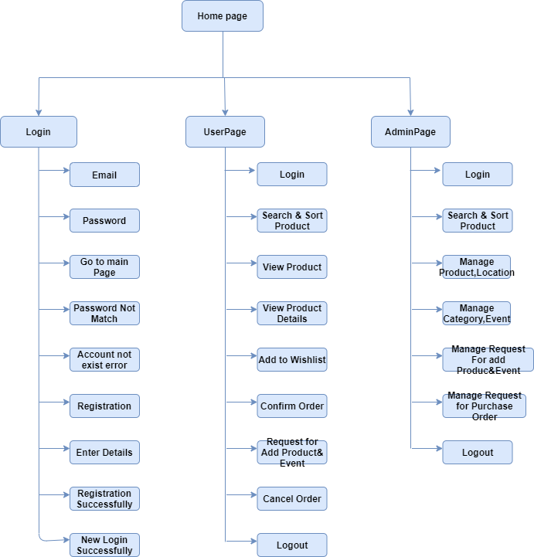
System Navigation

Slide 60
Input Output Design

Slide 61
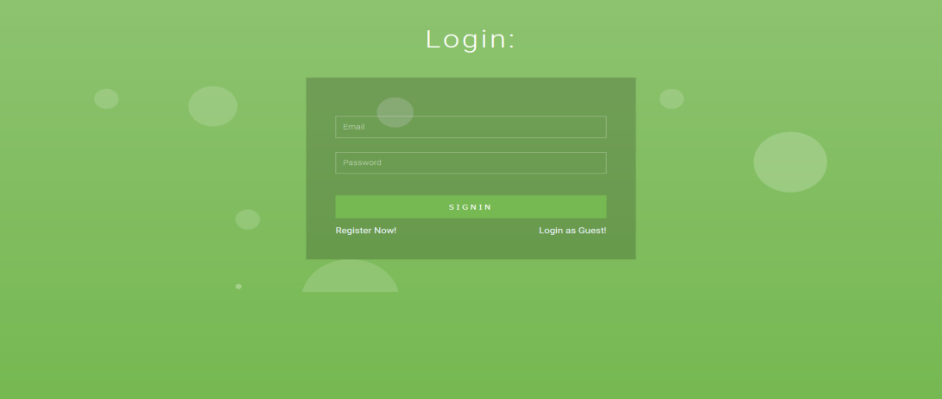
Login Page

Slide 62
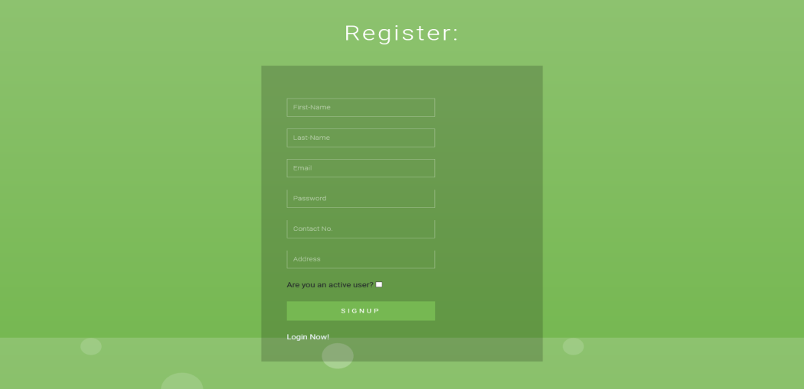
Registration Page

Slide 63
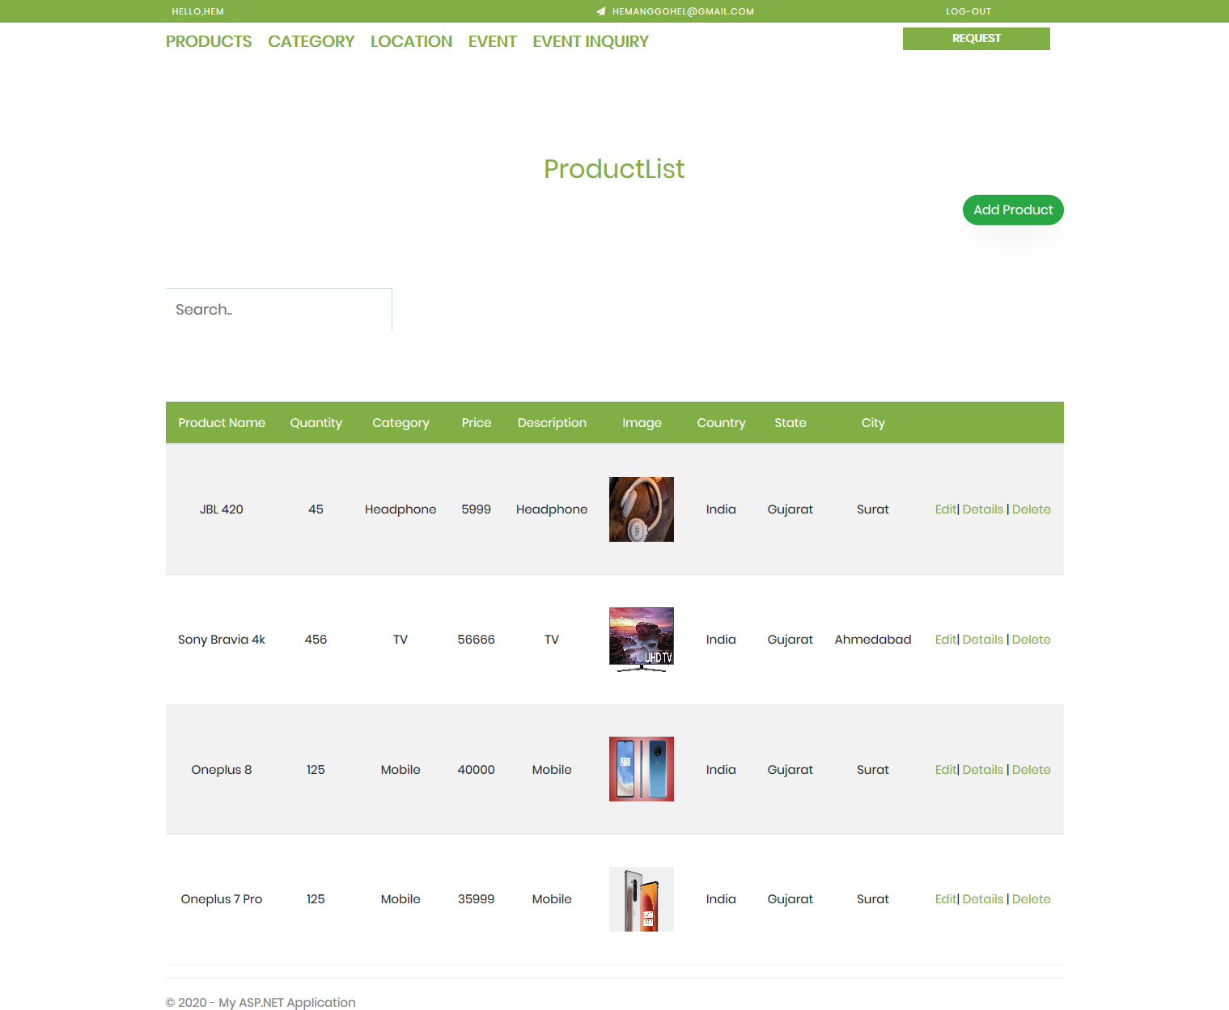
Admin Dashboard Page

Slide 64
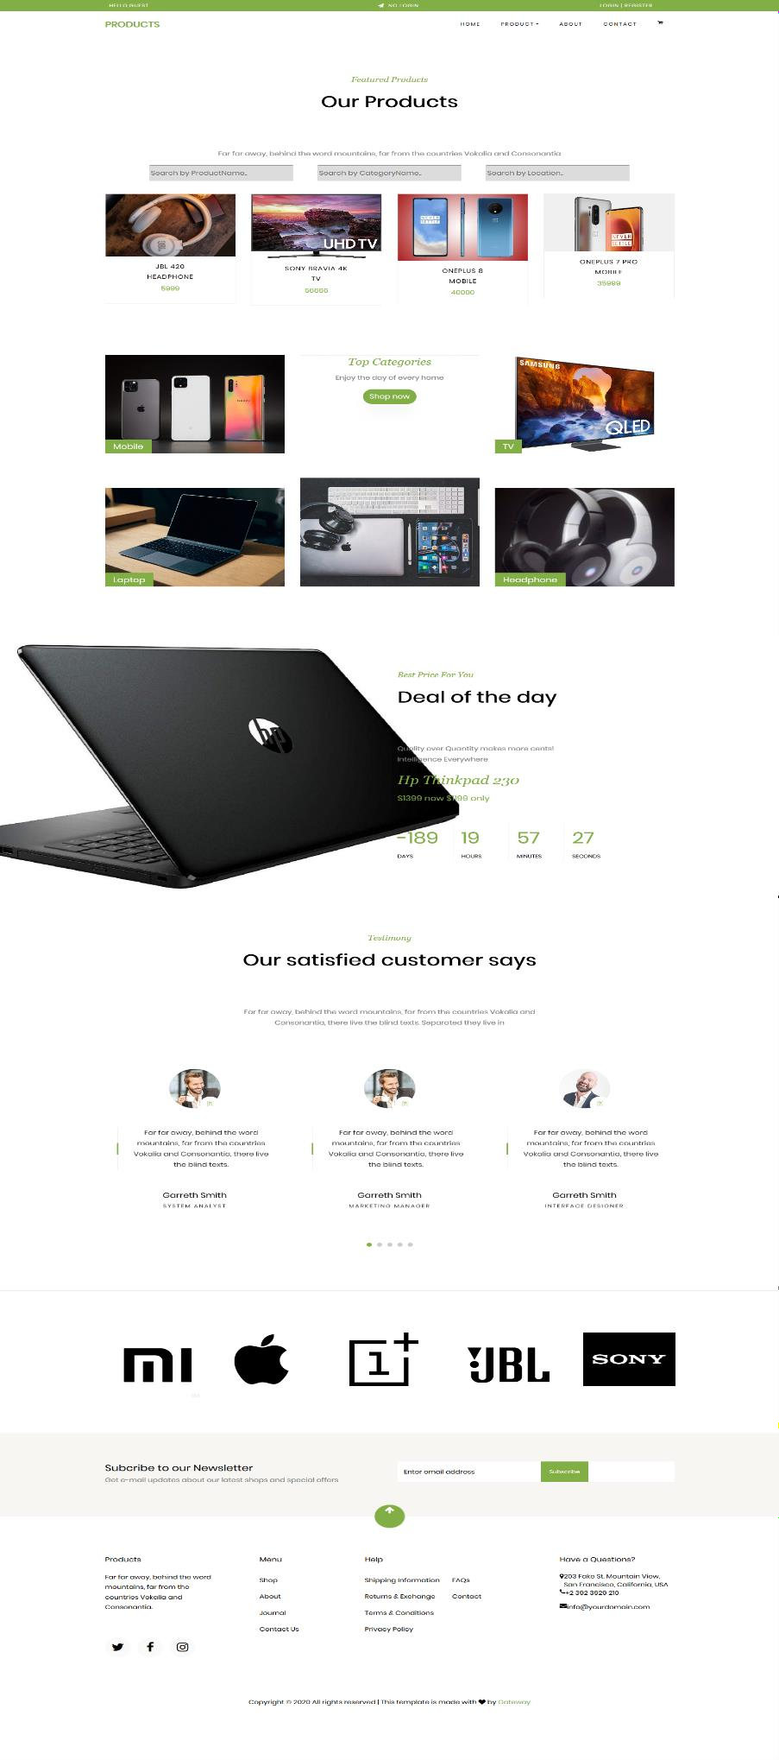
Product Portal Page

Slide 65
Product Portal Page

Slide 66
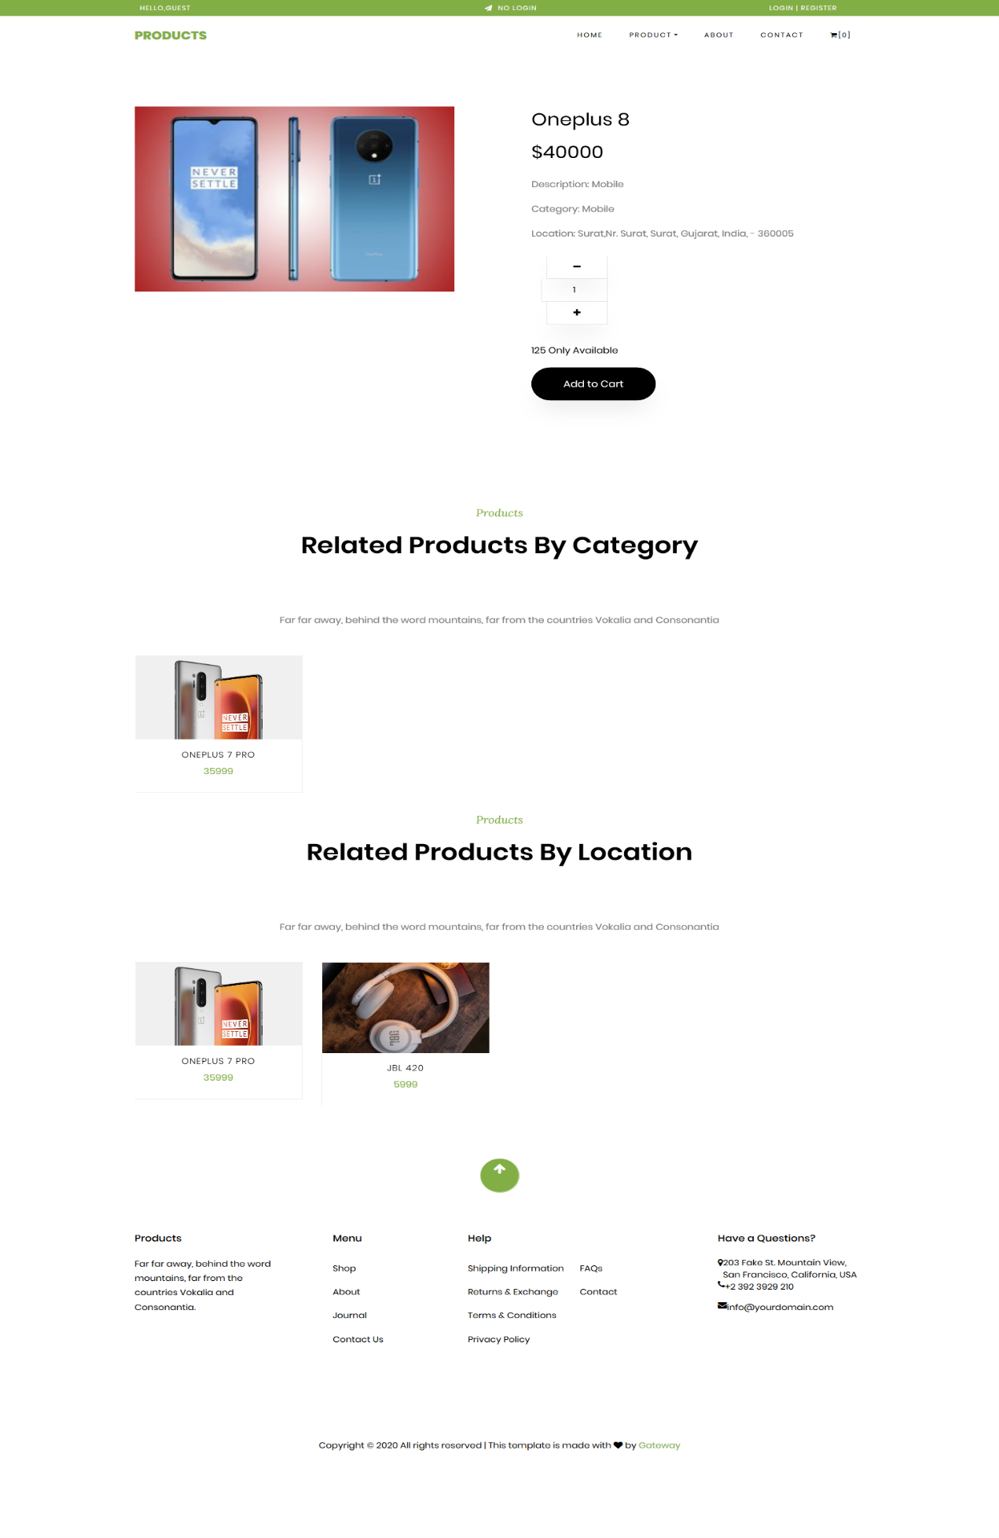
Product Details Page

Slide 67
Product Details Page

Slide 68
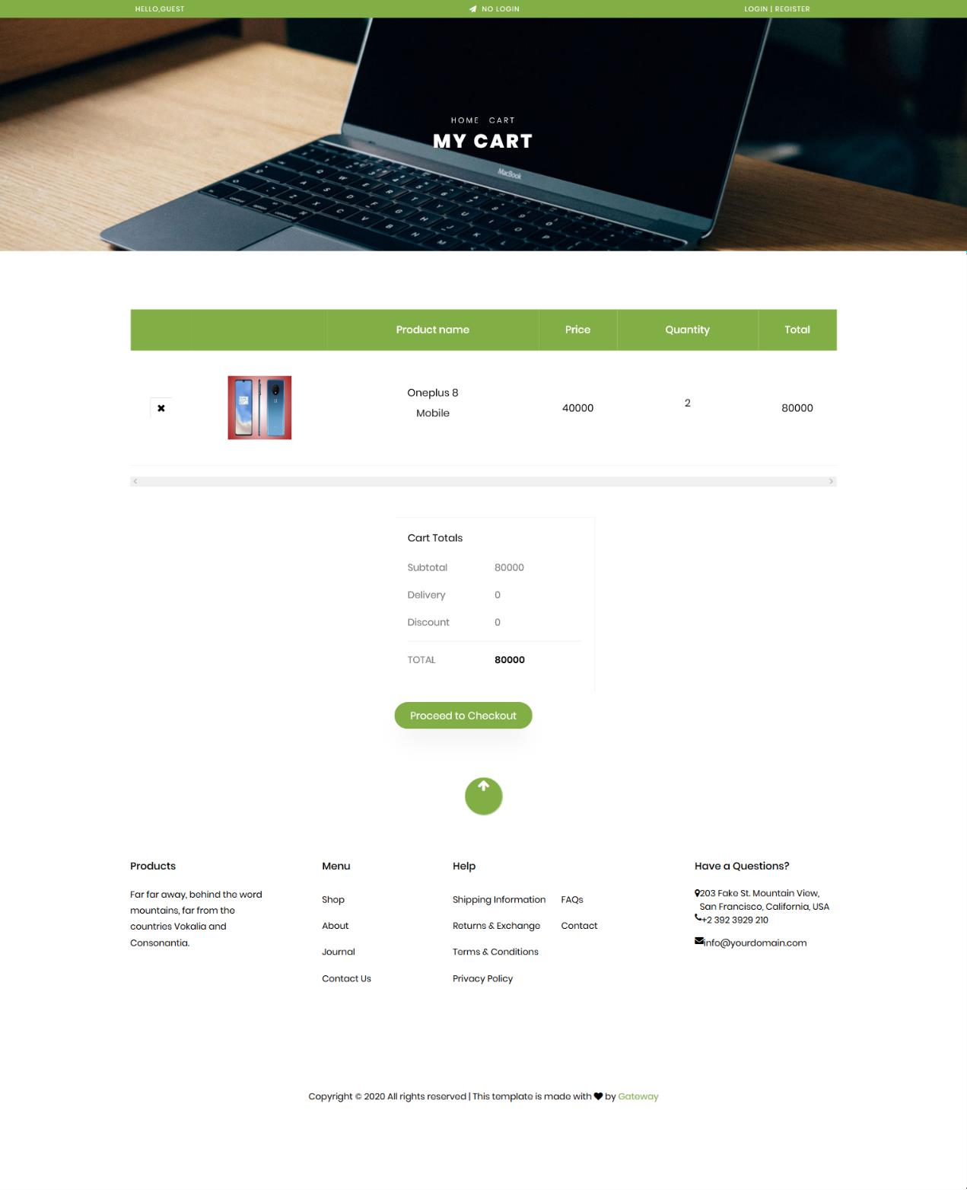
Product Cart Page

Slide 69
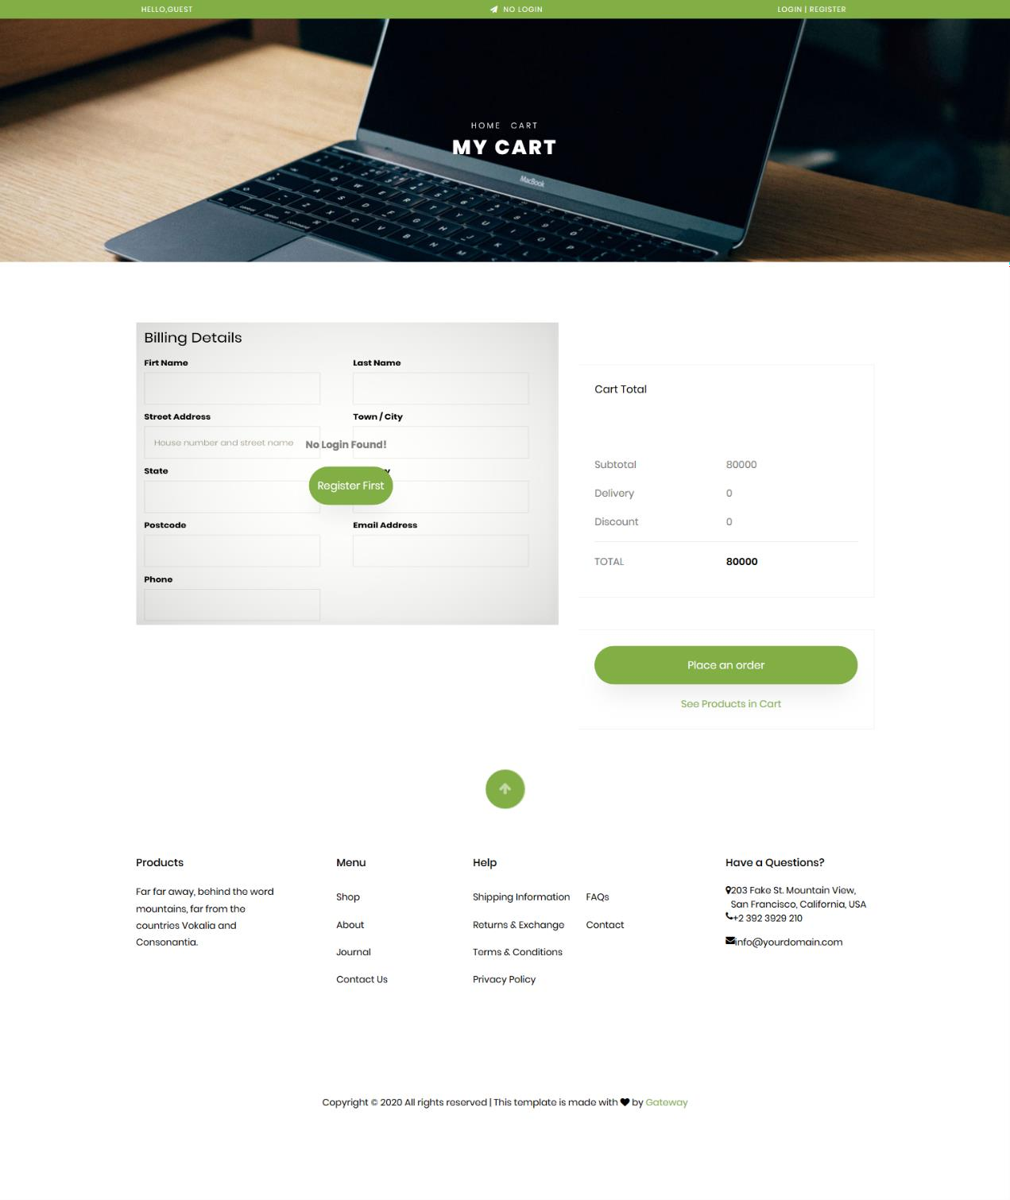
Product Checkout for Guest User Page

Slide 70
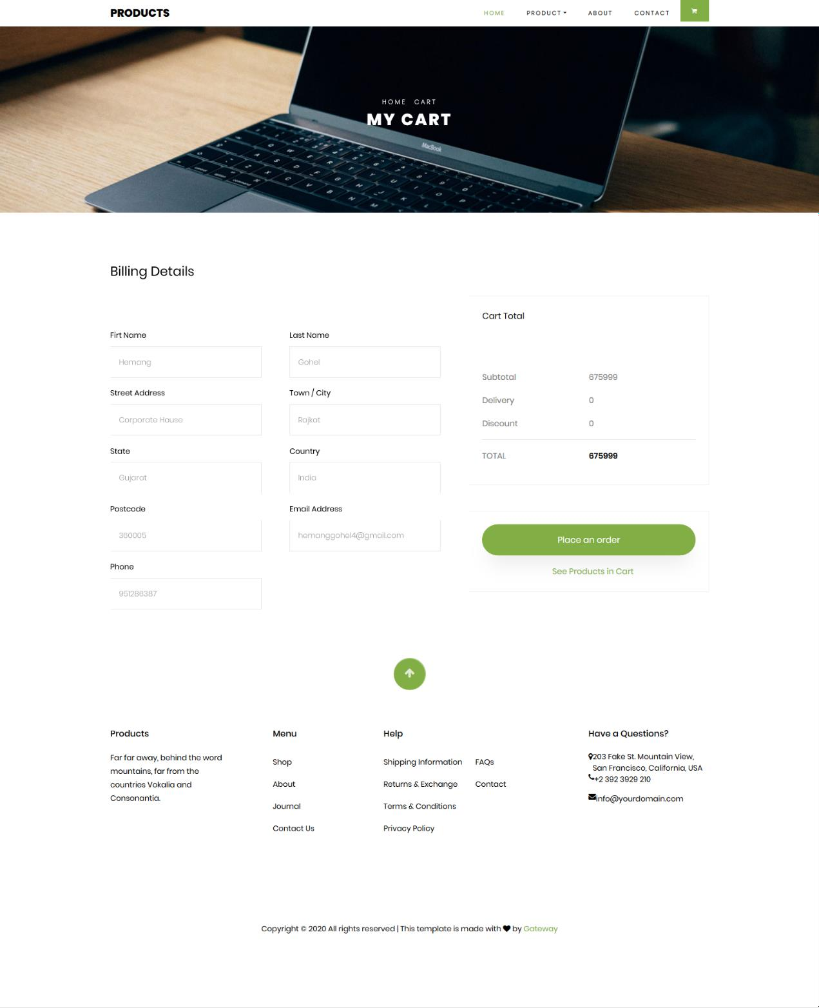
Product Checkout for Registered User Page

Slide 71
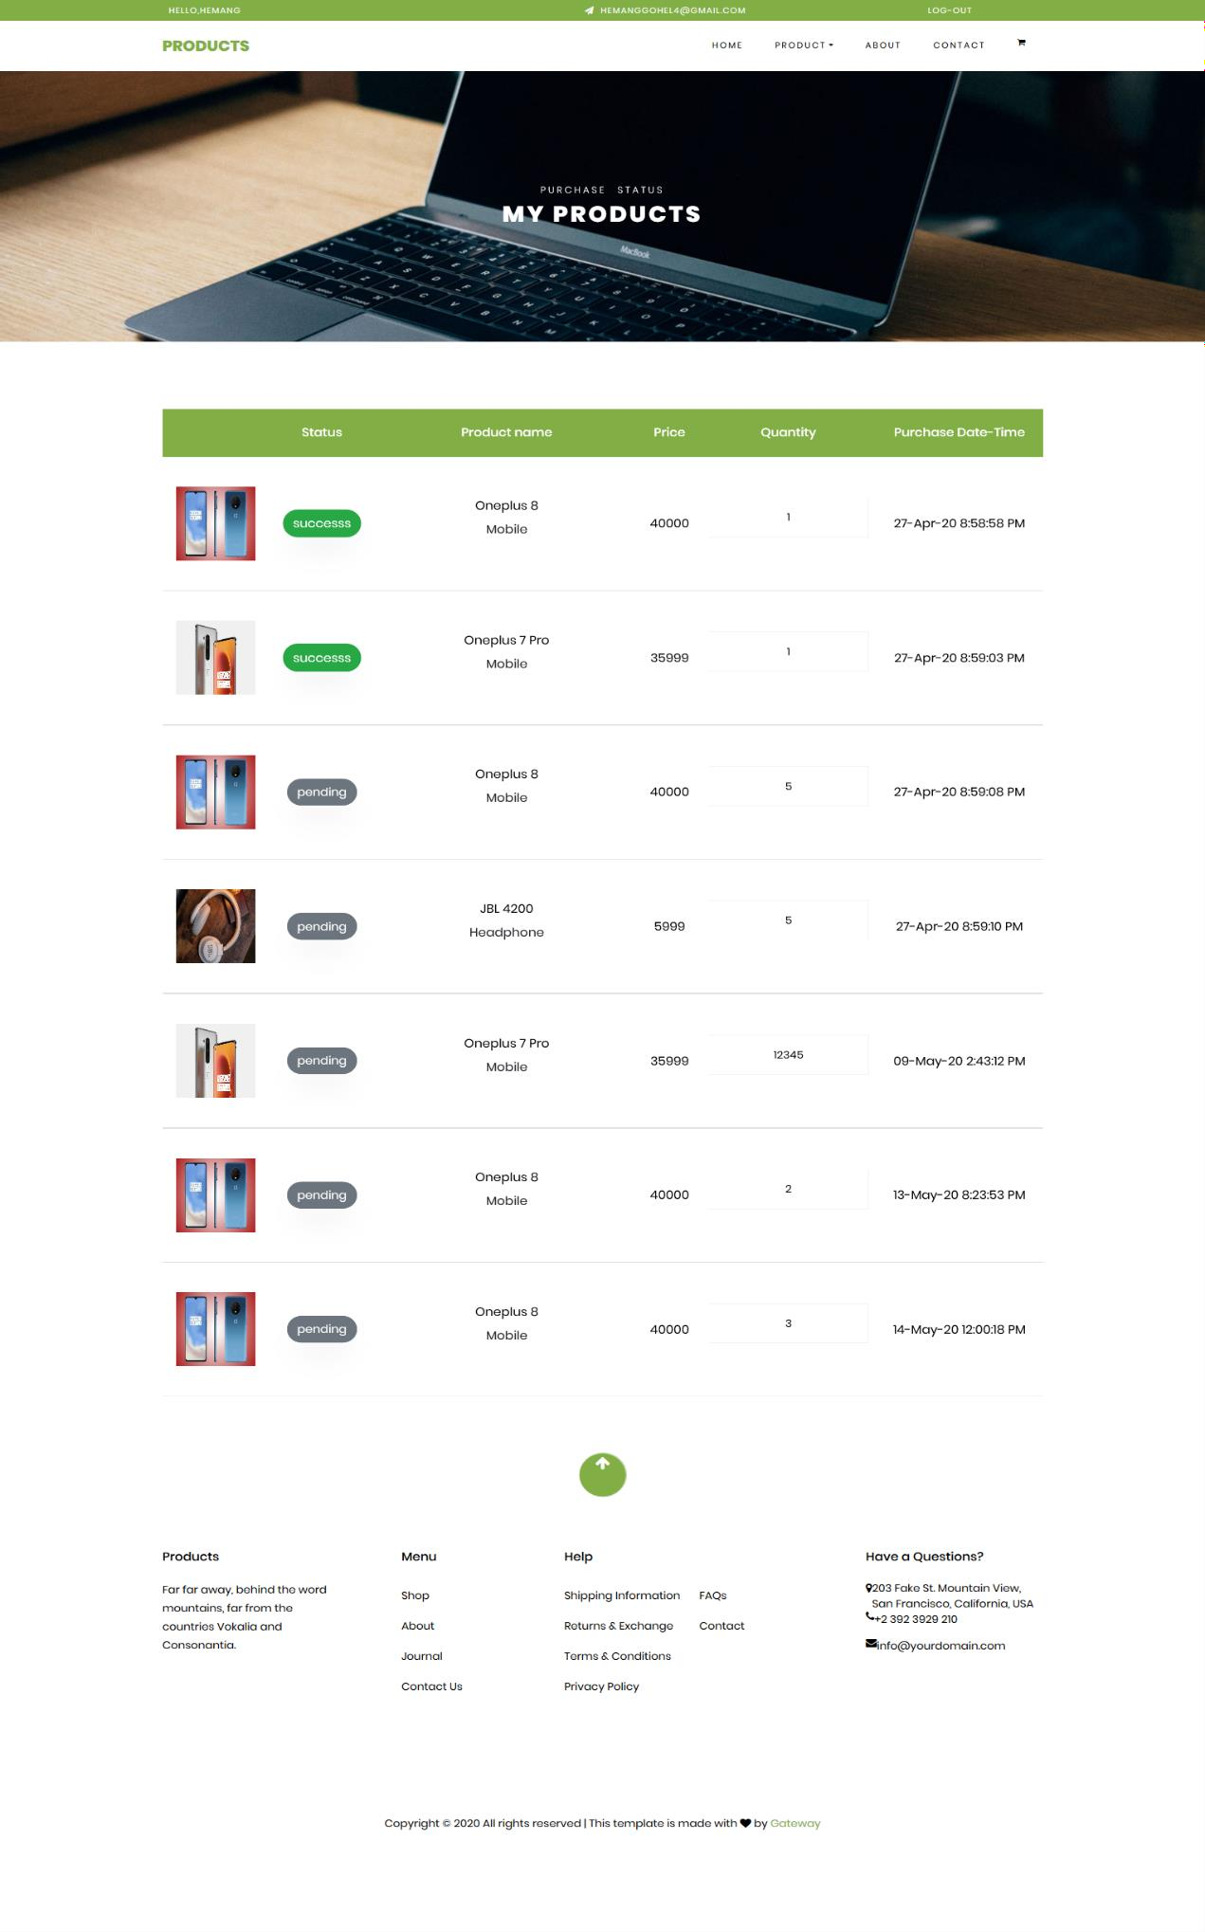
Product Purchase Status Page

Slide 72
Product Purchase Status Page

Slide 73
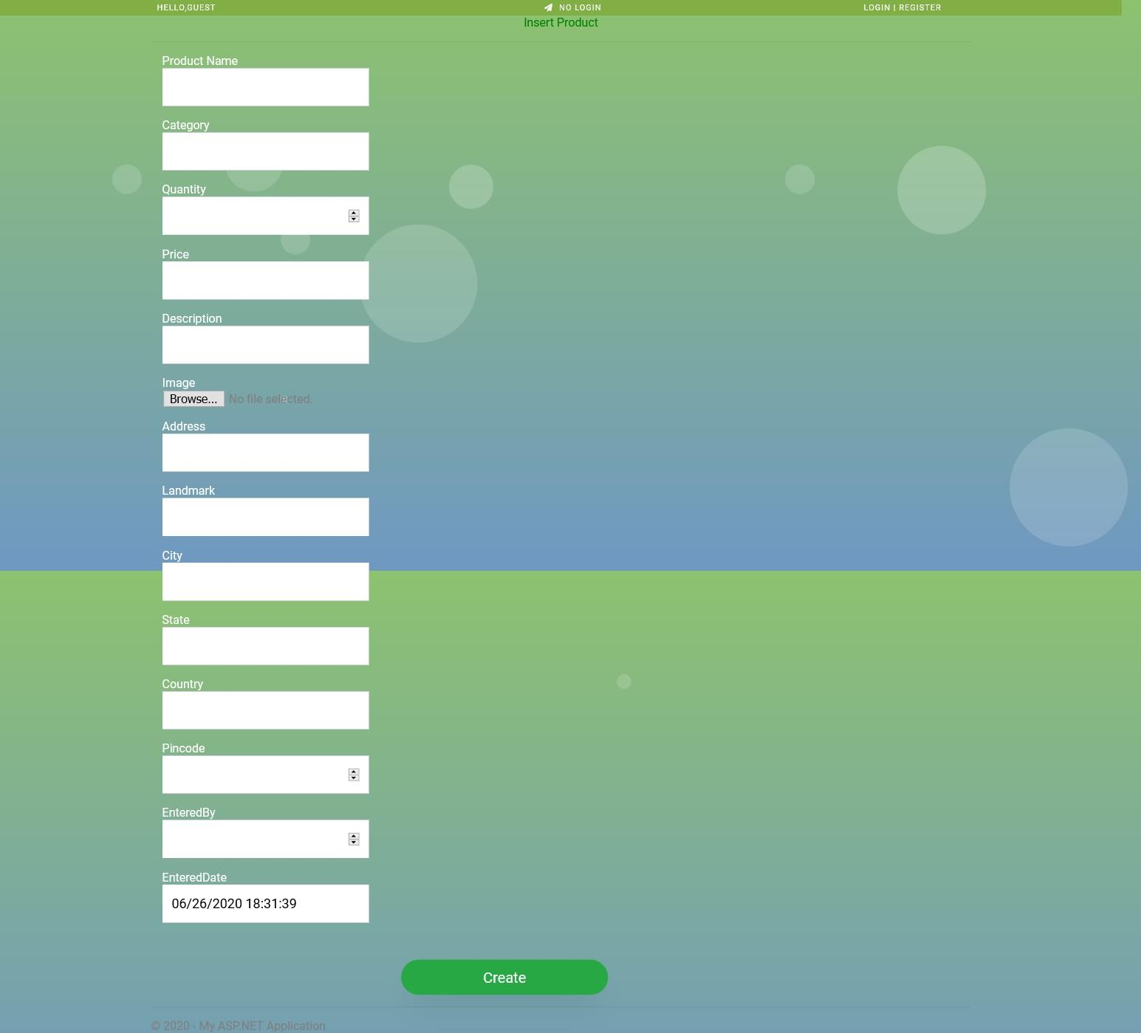
Request to Add New Product Page

Slide 74
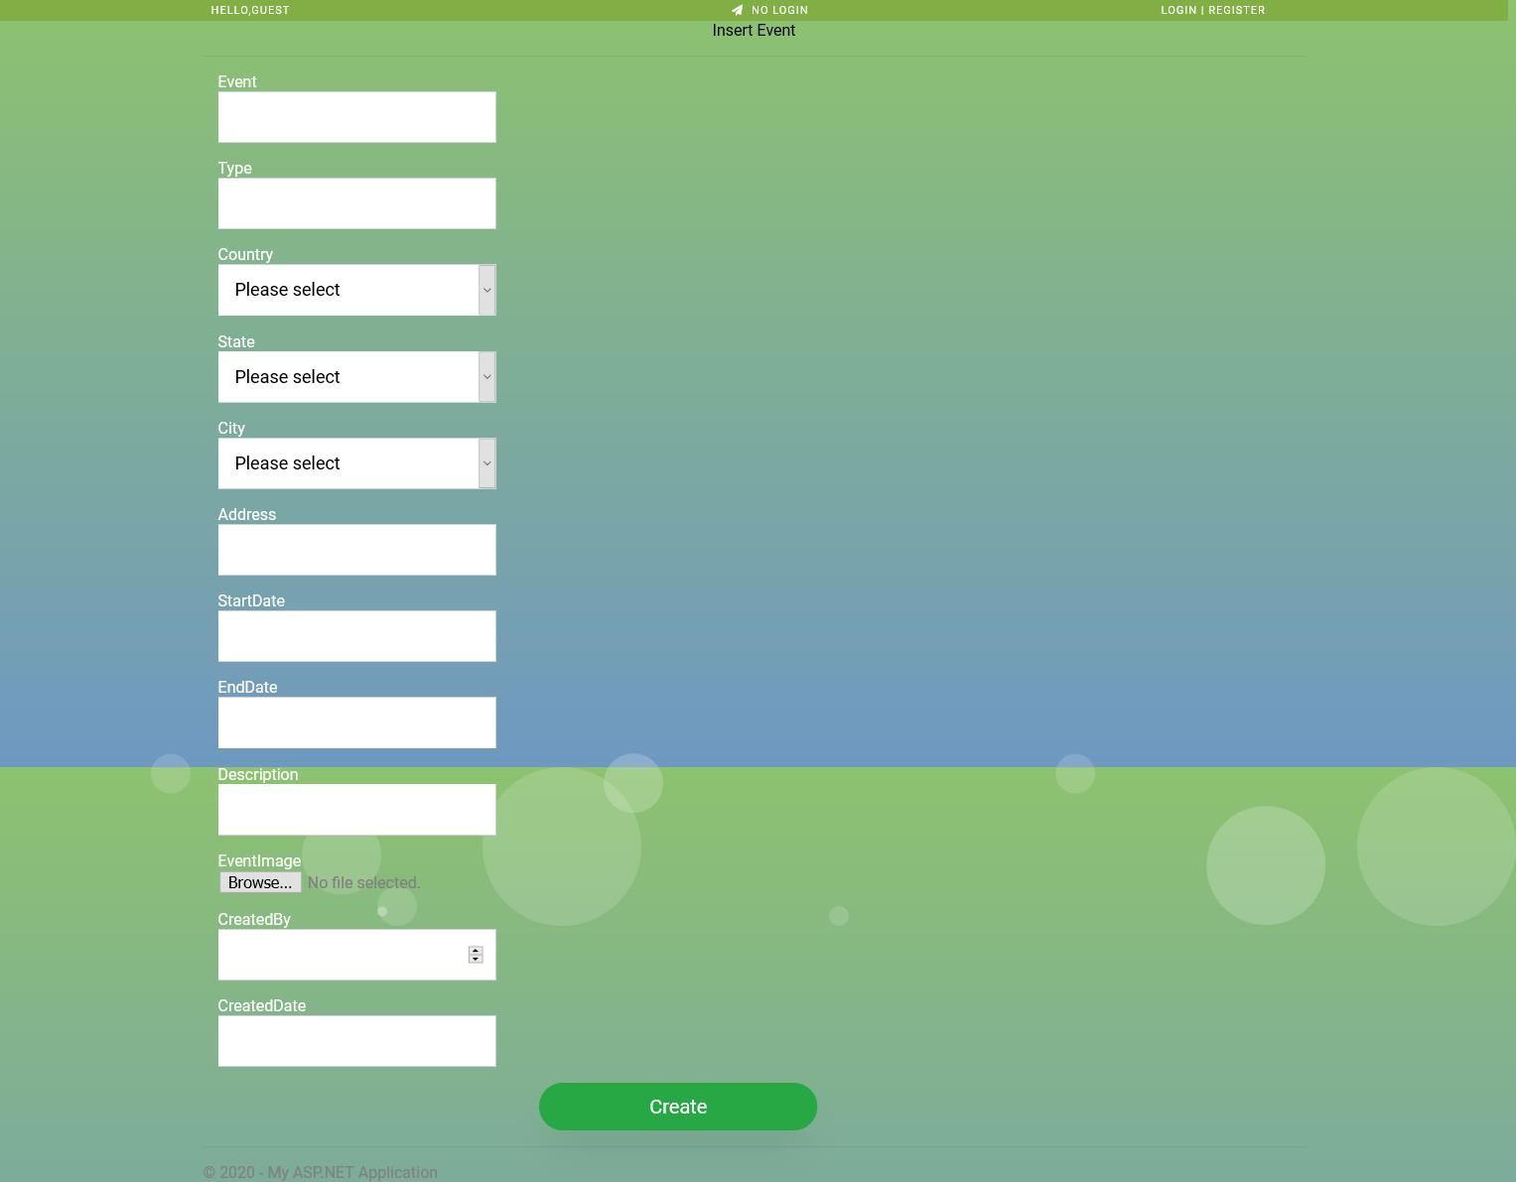
Request to Add New Event Page

Slide 75
Product-List with
Edit
Details
Delete

Slide 76
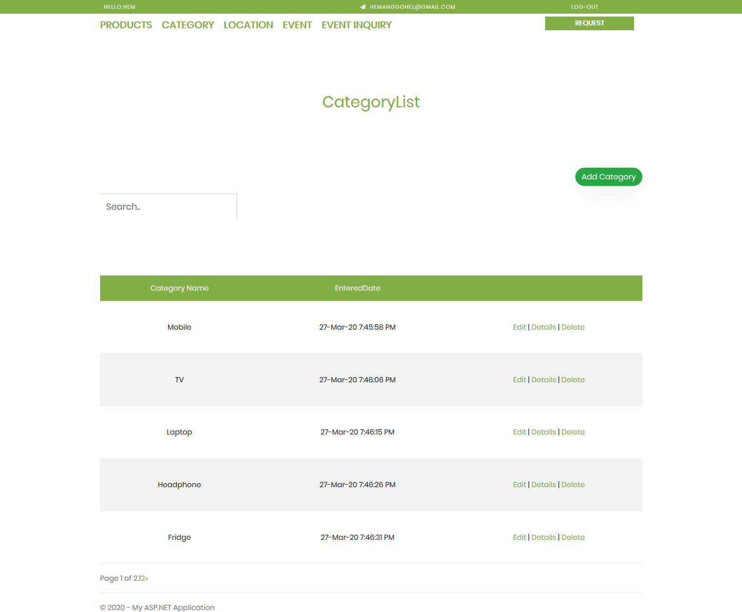
Category-List with
Edit
Details
Delete

Slide 77
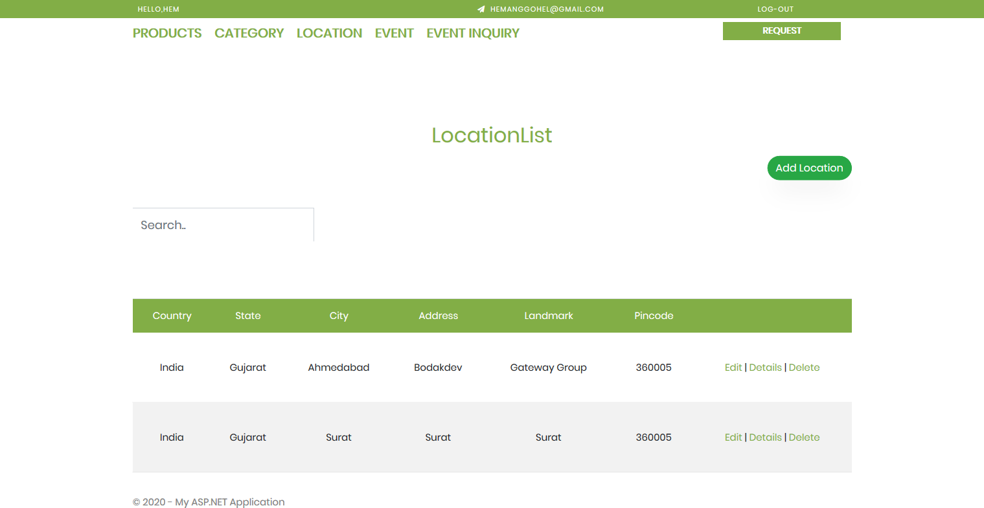
Location with
Edit
Details
Delete

Slide 78
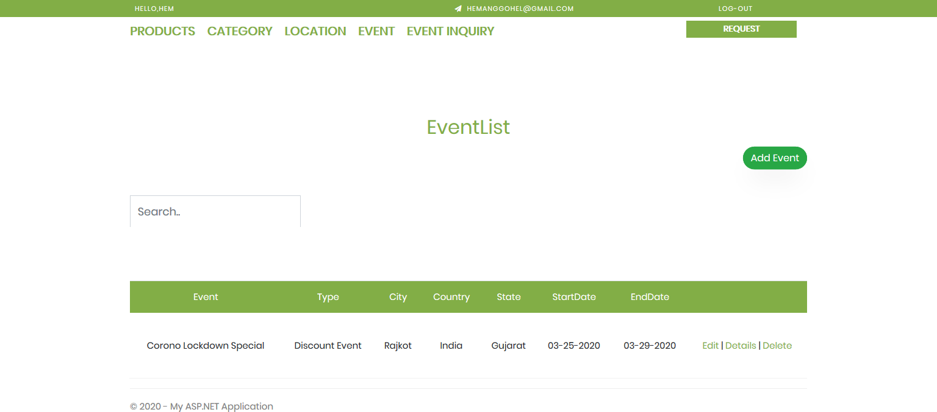
Event-List with
Edit
Details
Delete

Slide 79
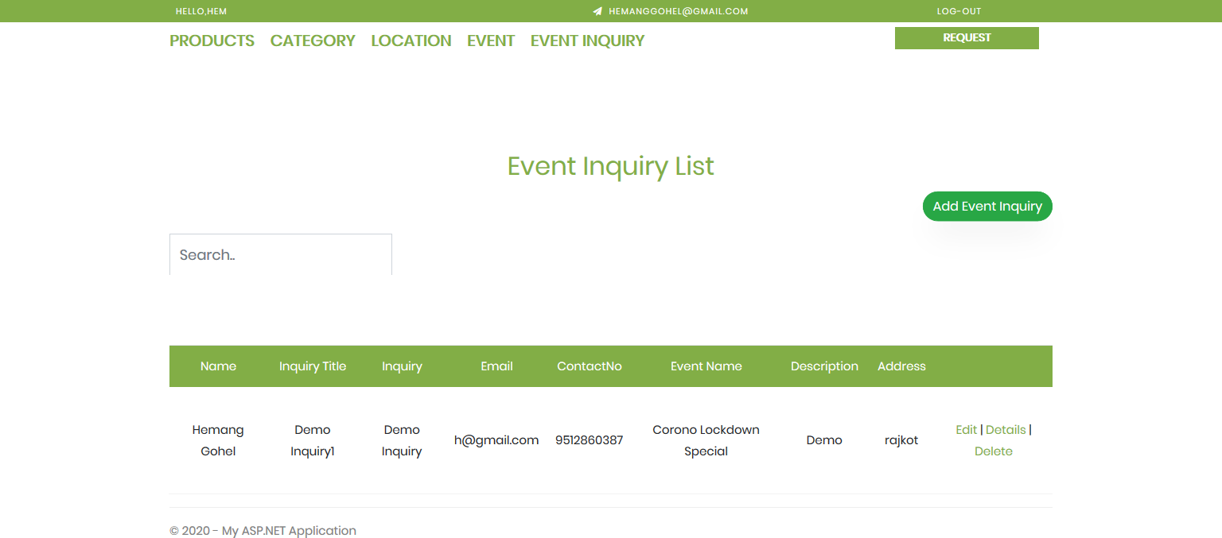
Event-Inquiry
List with
Edit
Details
Delete

Slide 80
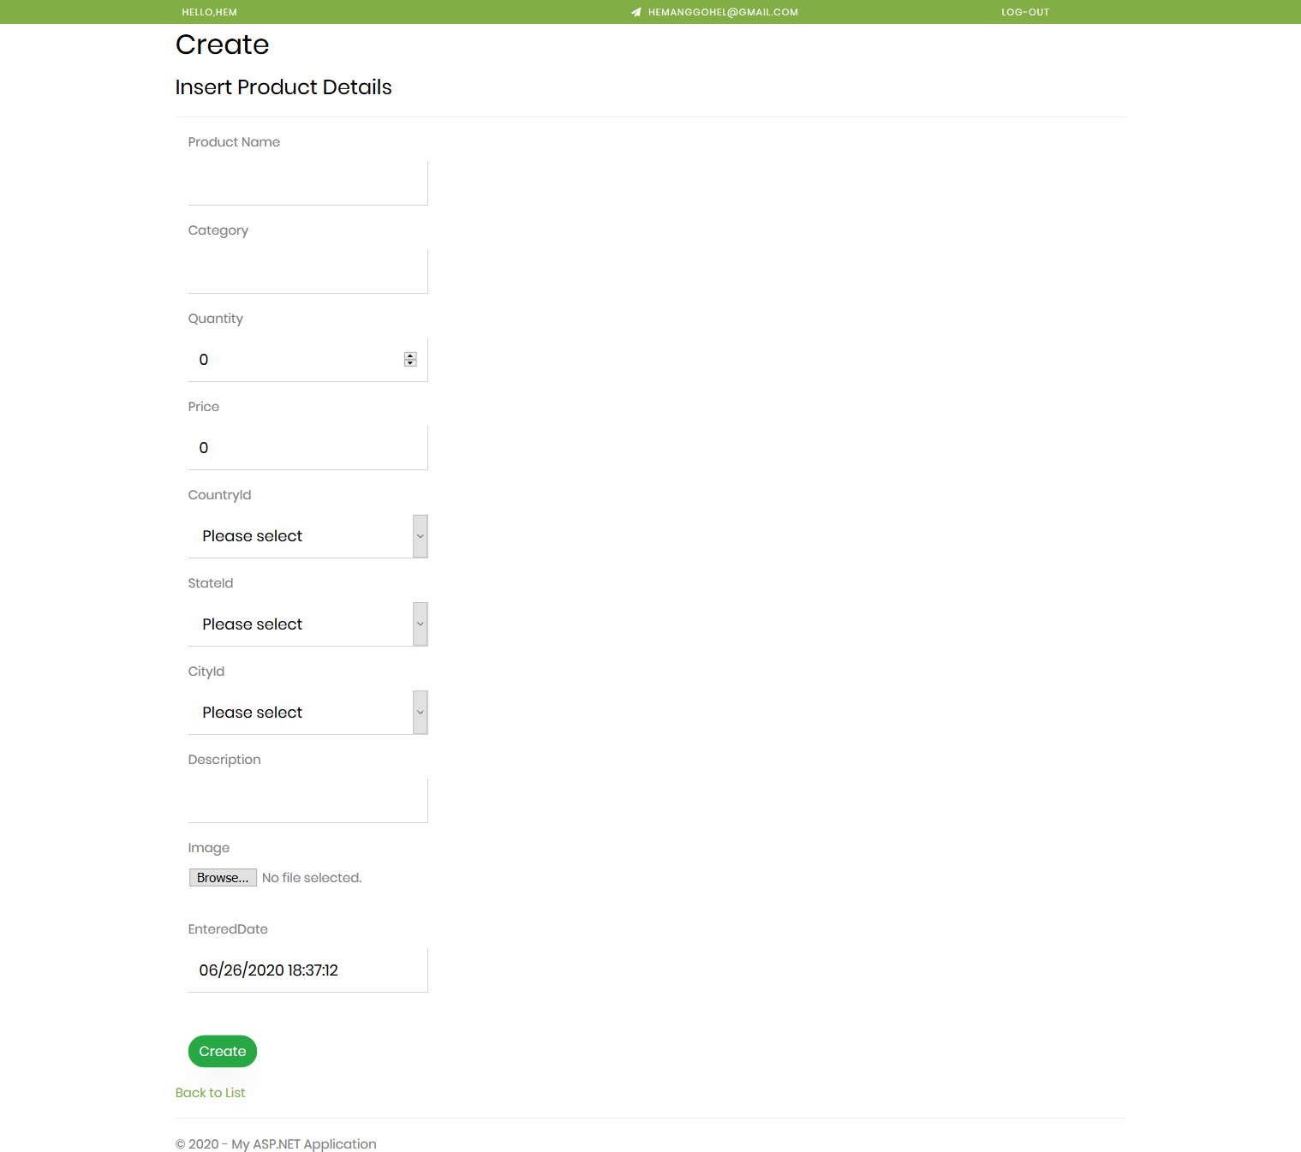
Add Product Page (Same for Categories, Locations and Events)

Slide 81
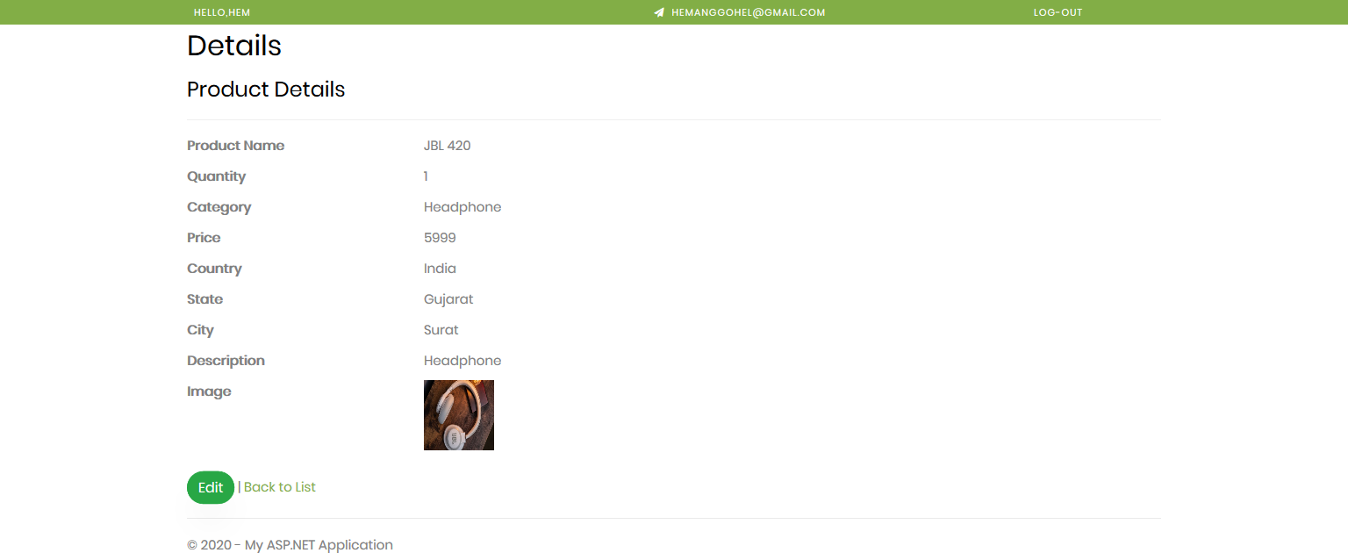
Product Details Page
(Same for Categories,
Locations and Events)

Slide 82
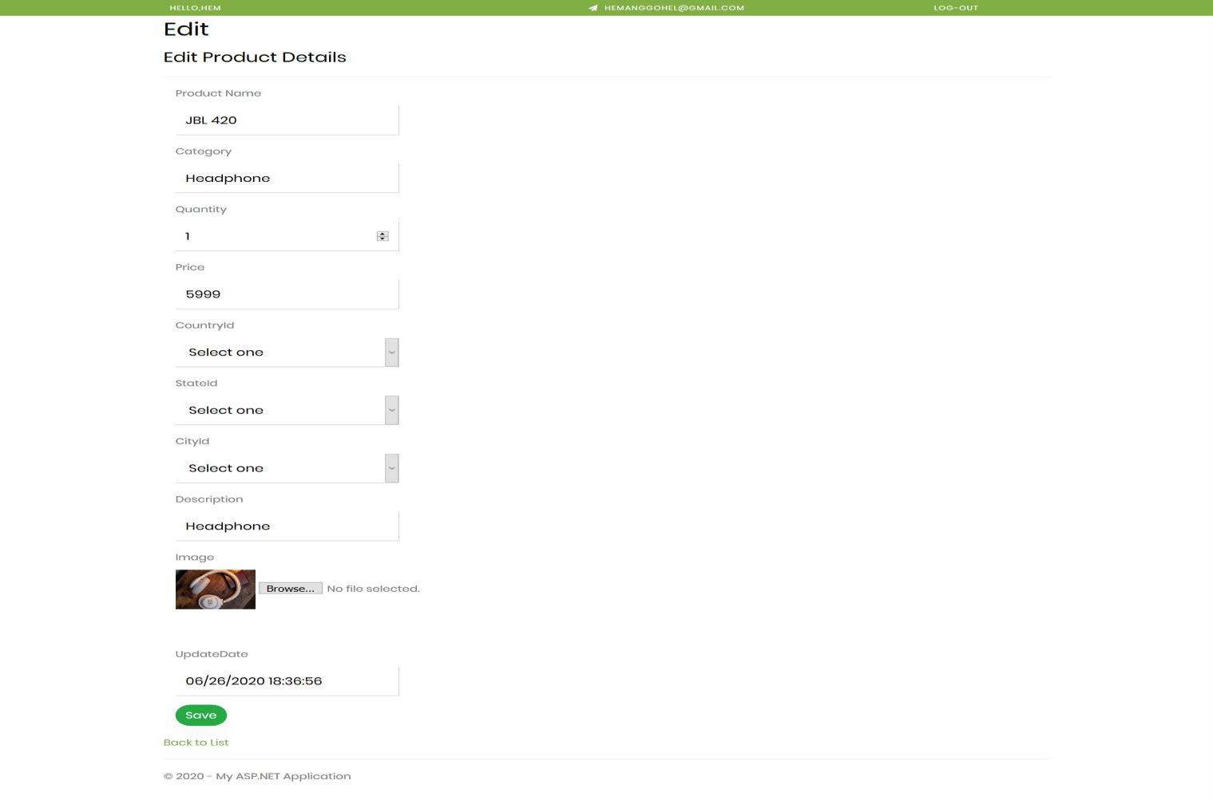
Edit Product Page
(Same for Categories, Locations and Events)

Slide 83
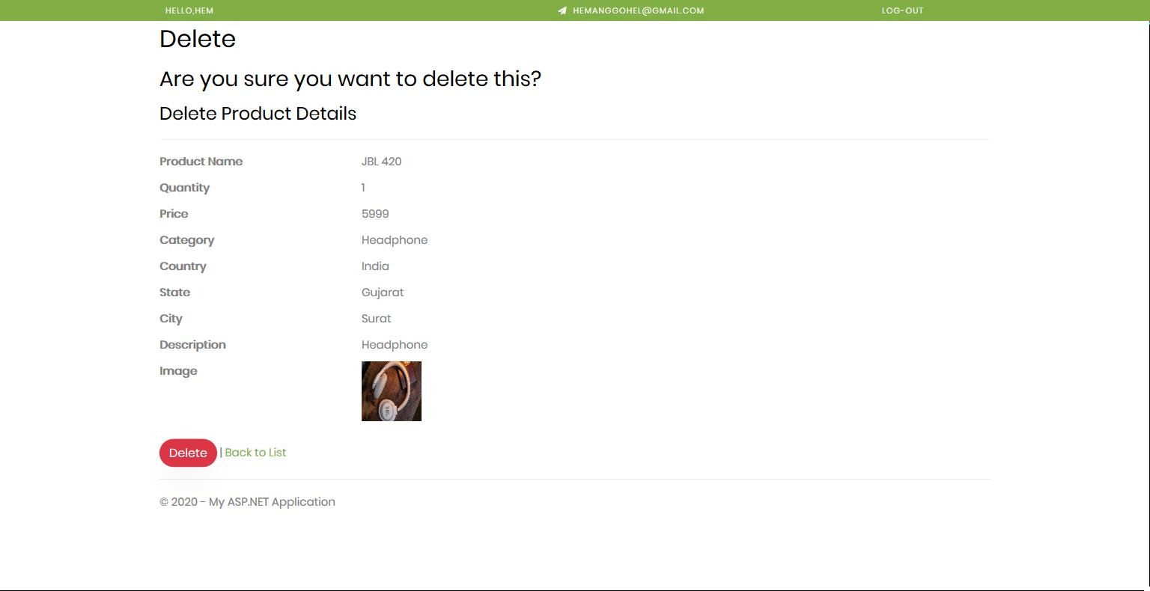
Delete Product Page
(Same for Categories, Locations and Events)

Slide 84
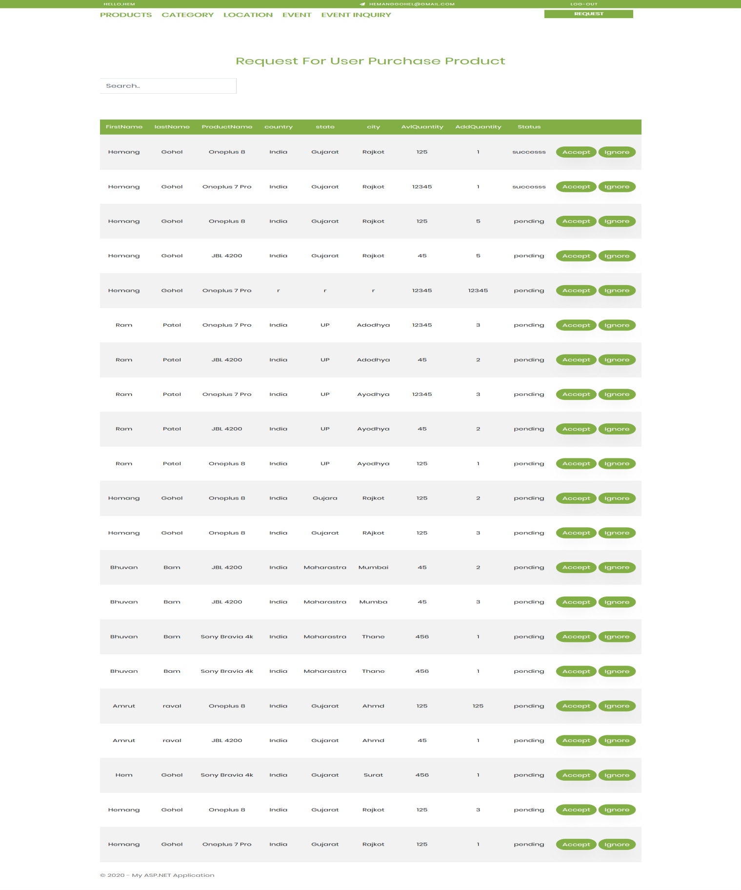
Product Purchase Request Page for Admin

Slide 85
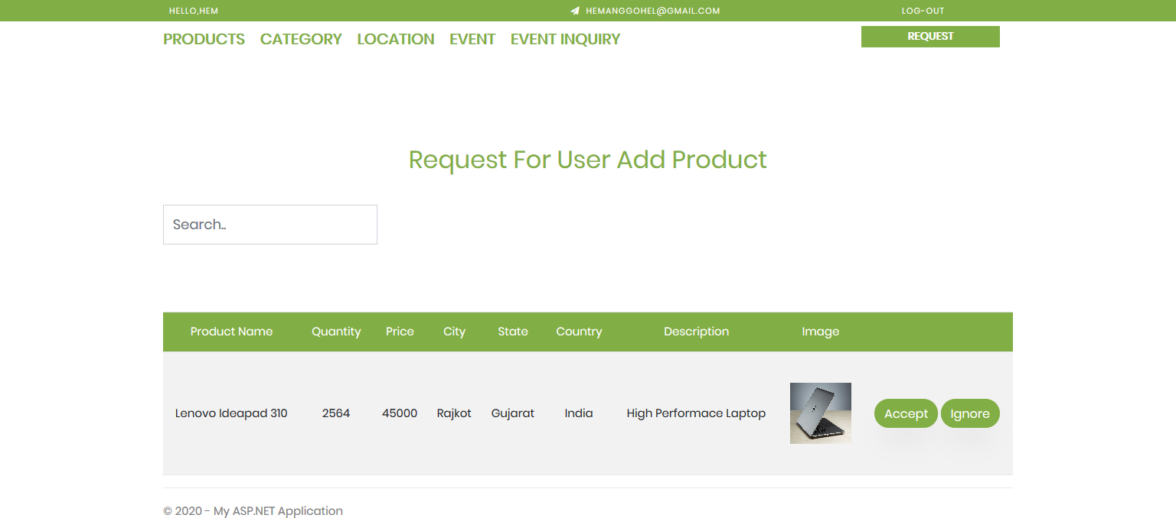
Add Product Request Page for Admin

Slide 86
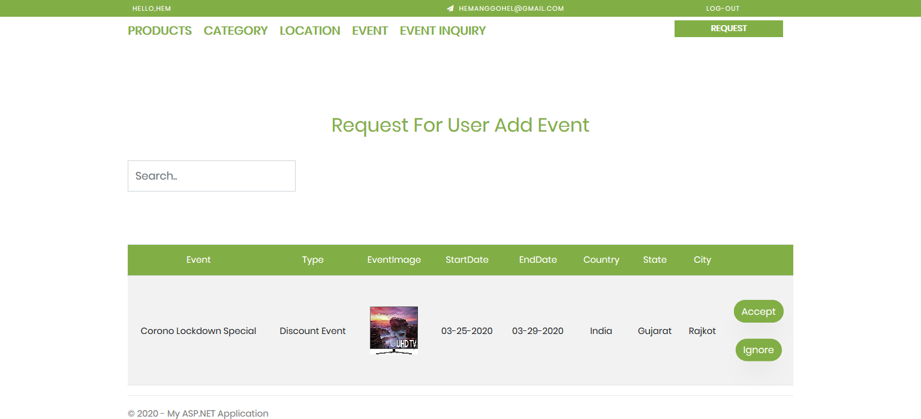
Add Event Request Page for Admin

Slide 87
System Testing
TESTING PLAN
The testing sub-process includes the following activities in a phase dependent
manner:
Create Test Plans.
Create Test Specifications.
Review Test Plans and Test Specifications.
Conduct tests according to the Test Specifications, and log the defects.
Fix defects, if any.
When defects are fixed continue from activity.

Slide 88
TEST CASES
Login & Register Module
TEST CASE | TEST SCENARIO | EXPECTED RESULT | PASS/FAIL
01 | Filling all the mandatory fields in login | Redirect to the dashboard | PASS
02 | Invalid login credentials | Error message displayed | PASS
03 | Keeping any field empty during login | Error message Displayed | PASS
04 | Filling all the mandatory fields in registration | Redirect to the login | PASS
05 | Invalid registration credentials | Error message displayed | PASS
06 | Keeping any field empty during registration | Error message displayed | PASS

Slide 89
Admin Dashboard Module
TEST CASE | TEST SCENARIO | EXPECTED RESULT | PASS/FAIL
01 | Create Products, Locations, Categories and Events | Add details to database | PASS
02 | Edit Products, Locations, Categories and Events | Update details to database | PASS
03 | Delete Products, Locations, Categories and Events | Remove details from database | PASS
04 | Generate Logs and Reports | Show all logs and Reports | PASS
05 | Update System Settings | Change application configurations | PASS

Slide 90
Registered
User Portal Module
TEST CASE | TEST SCENARIO | EXPECTED RESULT | PASS/FAIL
01 | Add Product to Cart(Wish list) | Add details to database | PASS
02 | Purchase a Product | Add purchase details to database | PASS
03 | Check Status of Product Purchasement | Return product purchasement status from database | PASS
04 | Request to Add Product | Add details to database | PASS
05 | Request to Add Event | Add details to database | PASS
06 | Search Product By Categories and Locations | Return related products from database | PASS
07 | On-click Product | Return details from database | PASS
08 | Generate Logs and Reports | Show all logs and reports | PASS
09 | Log-out | Log-out from portal & restrict to access. | PASS

Slide 91
Guest
User Portal Module
TEST CASE | TEST SCENARIO | EXPECTED RESULT | PASS/FAIL
01 | Add Product to Cart(Wish list) | Add details to database | PASS
02 | Request to Add Product | Add details to database | PASS
03 | Request to Add Event | Add details to database | PASS
04 | Search Product By Categories and Locations | Return related products from database | PASS
05 | On-click Product | Return details from database | PASS
06 | Generate Logs and Reports | Show all logs and reports | PASS

Slide 92
SUMMARY

Slide 93
LIMITATIONS
Proper internet connection is required to smoothly use web application.
Current systems do not support return and replacement of products.
Current systems do not provide functionality to cancel pre-requested orders.
Current systems do not support payment gateway for product purchasement.
Current systems do not provide functionality to share product details to others

Slide 94
FUTURE ENHANCEMENT
Pre-Requested Orders Cancellation can be implemented.
Payment Gateway for Product Purchasement can also be added.
Share Product Details to Others can be provided.
User contact/complaint forum can be implemented.

Slide 95
CONCLUSION
This web application that we have developed is very useful to purchase a product according to their requirement they can search the category and location and get the data related their requirement.
It is a process of promoting and selling a product to a customer, also it is defined as being the intermediary function between product development and increasing brand awareness.
It requires continues development, testing and publish. This web application eases the process of testing and deployment of software/applications.
Also, this application gives functionality of interact with portal as guest user, guest can interact with system same as registered user except product purchasement.
Admin can see logs, manage portals data, user access information, system configurations and reports of same.

Slide 96
Bibliography
Wikipedia,” Visual Studio, SQL Server, C# & .NET framework” https://en.wikipedia.org/wiki/
Simplilearn,” Project Feasibility”
https://www.simplilearn.com/feasibility-study-article
Projectmanager, “Project Planning and Scheduling”
https://www.projectmanager.com/project-planning
Opentextbc, “Project implementation planning”
https://opentextbc.ca/projectmanagement/chapter/chapter-17-project-implementation- overview-project-management/

Slide 97
Geeksforgeeks, “Coding standards in project report”
https://www.geeksforgeeks.org/coding-standards-and-guidelines/
Softweretestinghelp, “Project Testing”
https://www.softwaretestinghelp.com/test-project-planning/
Wrike, “Agile Methodology”
https://www.wrike.com/project-management-guide/faq/what-is-agile-methodology-in- project-management/
Draw.io, “Project Diagrams”
https://app.diagrams.net/

Slide 98


